Slide 1

MOBILE BANKING APP
FingerTip Banking

Slide 2
TABLE OF CONTENTS
01
02
03
04
PROJECT DESCRIPTION
PROGRAM OBJECTIVES
Brief description of the project
CODE OUTPUT
The specified objectives for the project
OUR TEAM
Outputs on the console of the program
Group members names and student numbers

Slide 3
PROJECT DESCRIPTION
FingerTip is an electronic payment system that enables customers of a bank or other financial institution to conduct a range of financial transactions through the financial institution's website. The online banking system will typically connect to or be part of the core banking system operated by a bank to provide customers access to banking services in place of traditional branch banking. Online banking significantly reduces the banks' operating cost by reducing reliance on a branch network and offers greater convenience to customers in time saving in coming to a branch and the convenience of being able to perform banking transactions even when branches are closed. Internet banking provides personal and corporate banking services offering features such as viewing account balances, obtaining statements, checking recent transactions, transferring money between accounts, and making payments

Slide 4
OBJECTIVES
To design an internet banking web that has high security, that is username and password protected, by that way we are confident that only the real owners can login on their internet bank account.
To design a create an account window, where you will write your personal details to be verified by the Bank, types of account you want to create (saving or current) account, and the initial deposit.
To include a virtual card that is stored on the banking system and can be used to pay contactless in store or online, has its own unique card number, expiry date and cvv.

Slide 5
OBJECTIVES
To see you bank balance, transfer cash, or make a payment on you existing account any time you want to on your internet banking system.
To buy prepaid like airtime, voucher, data and even electricity any time you want to on your internet banking system, using your funds.
To have a system that you can log-out to when you are done using it, and to be used again you will have to login using your username and password, and get verified by the bank if it corrects, that way we are ensuring high security.

Slide 6
03
CODE OUTPUT
The following slides show the output of the running project

Slide 7
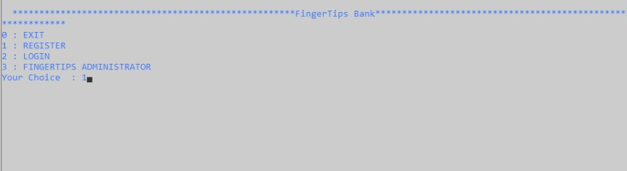
WELCOME SCREEN
The above screen shows the first screen the user sees when using FingerTip banking.
The user is given four options to choose from:
0. Exit – to exit the program
Register – this is for a new user
Login – this is for an existing user
FingerTips Administrator – for administrator use
The user enters the number of their choice. E.g. 1

Slide 8
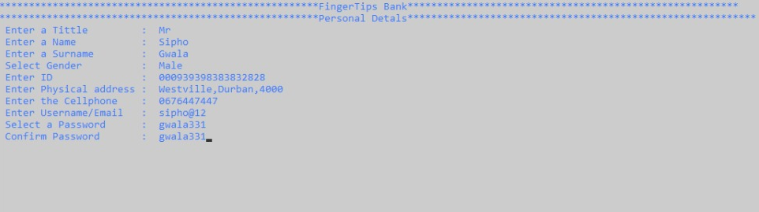
REGISTER SCREEN – Enter Personal Details
This screen prompts the user to enter their personal details to register as a new user.
Once they have entered their personal details they press Enter to proceed

Slide 9
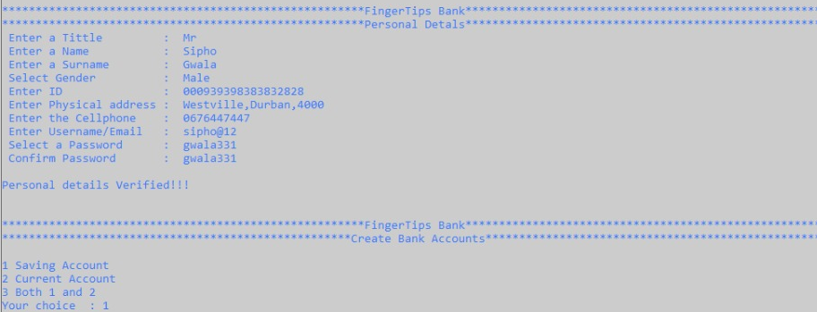
CREATE ACCOUNT SCREEN
Once the users personal details have been verified, there is a message saying “Personal Details Verified” and they are taken to a “Create Bank Accounts Screen”.
The user is given 3 options:
Saving Account
Current Account
Both Accounts
The user enters a number depending on the account they want to create

Slide 10
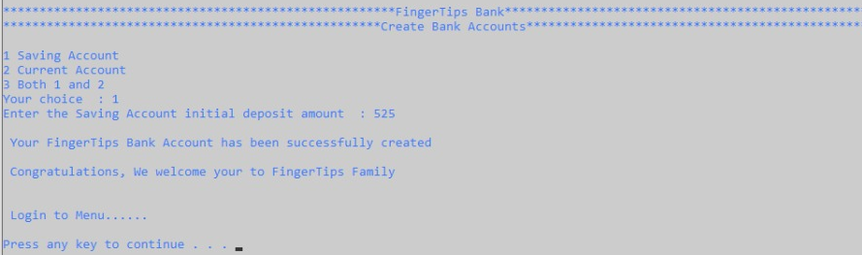
CREATE ACCOUNT SCREEN
The above screen is displayed when the user selects 1 or 2 to create a savings account or current account.
They are then requested to make an initial deposit into that account.
Once the initial deposit has been made, the user gets a confirmation message “Your FingerTips bank account has been successfully created…”

Slide 11
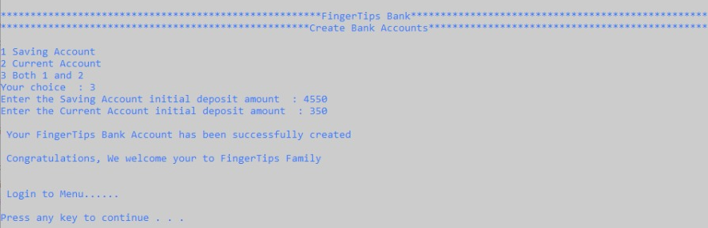
CREATE ACCOUNT SCREEN
The above screen is displayed when the user selects 3 to create both, a savings account and current account.
They are then requested to make an initial deposit into both accounts.
Once the initial deposit has been made, the user gets a confirmation message “Your FingerTips bank account has been successfully created…”

Slide 12
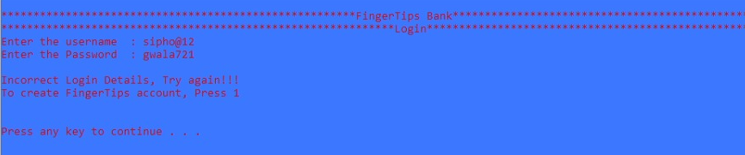
LOGIN SCREEN
The user is requested to enter their username and password to logon to the banking app.
If the username and/or password is incorrect, a message “Incorrect Login Details, Try Again!!!” is displayed and the colour of the Console becomes blue.
If the user has not created an account and tried to login, they have the option to create FingerTips account by pressing 1.

Slide 13
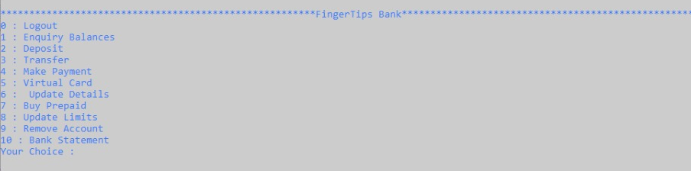
LOGIN MENU SCREEN
The above screen is shown once the user logs in.
The user has a list of options and features:
0. Logout – to log out of the banking app
Enquiry Balances – to view their account balances
Deposit – to make a deposit into their accounts
Transfer – to transfer money from savings account to current account and vice versa
Make Payment – to make any payment
Virtual Card – to view their virtual banking card
Update Details – to update users personal details
Buy Prepaid – to purchase prepaid vouchers, data, airtime or electricity
Update Limits – to update their card limits (transfers, payment and deposit limits)
Remove Account – to delete their bank account from FingerTips banking
Bank statement– to view their transactions
The user enters the number of their choice.

Slide 14
03
LOGIN SCREEN FUNCTIONALITY
The following slides show the functionality of the login menu screen

Slide 15
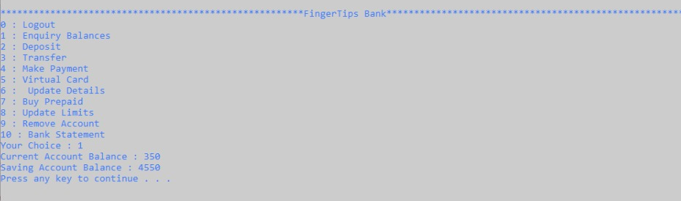
1. ENQUIRY BALANCES
If the user selects 1 (enquire balances), the above screen will be displayed.
This screen displays the balances of the users current account and savings account.
The user is requested to press any key to continue using the banking app.

Slide 16
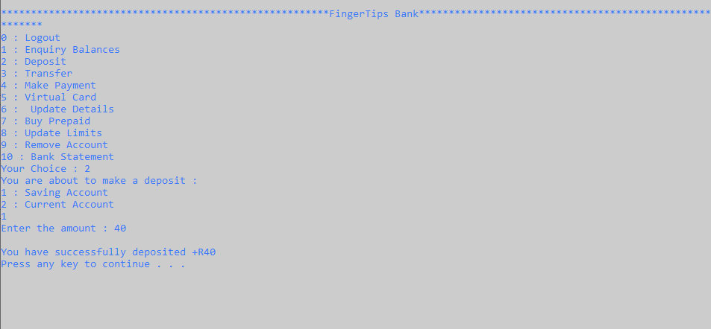
2. DEPOSIT
If the user selects 2 (deposit) they are given another two options to choose which account to deposit money into:
Savings Account
Current Account
The user enters their choice and will Press Enter. E.g. 1
Once selecting their choice, the user enters an amount to be deposited into the selected account
A message “You have successfully deposited +450” is displayed, if the deposit was successful

Slide 17
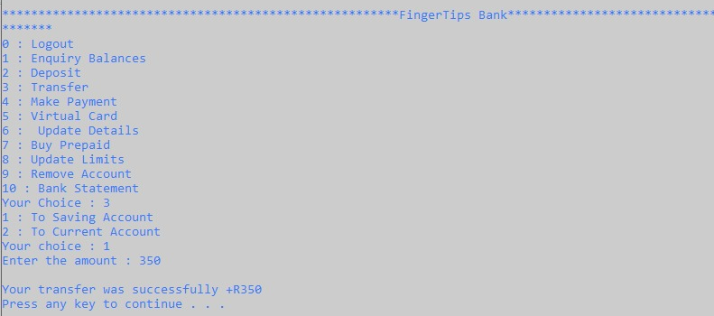
3. TRANSFER
If the user selects 3 (transfer), they are given two options:
To saving account
To current account
The user enters the number of their choice, depending on the account they want to transfer to
Once they enter their choice, they are prompted to enter the amount they want to transfer.
If the transfer was successful, they receive a message stating successful transfer

Slide 18
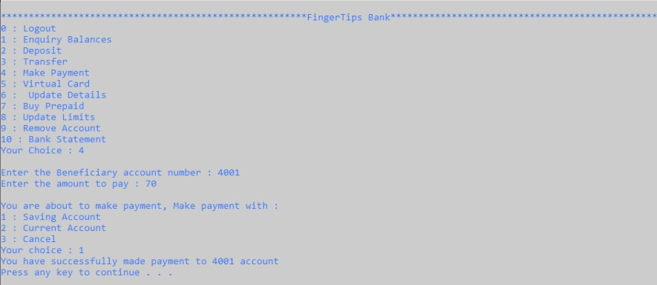
4. MAKE PAYMENT
If the user selects 4 (make payment), the user is given two prompts:
Enter the beneficiary account number
Enter the amount to pay
The user is then told they are about to make payment and is given three options:
Saving Account – make payment from saving account
Current Account – make payment from current account
Cancel – to cancel payment
The user enters the number of their choice
A confirmation message “You have successfully made payment to (account number) account” is displayed

Slide 19
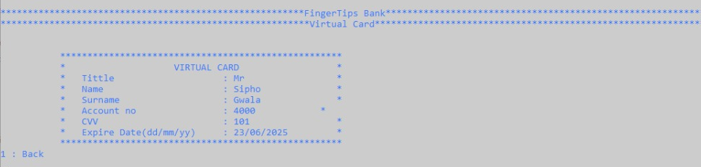
5. VIRTUAL CARD
If the user selects 5 (virtual card), their virtual bank card is displayed.
The user is given the option
1. Back – to go back to the main menu

Slide 20
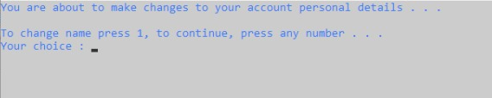
6. UPDATE DETAILS
If the user selects 6 (update details), a message is shown indicating the user is about to make changes to the account personal details
The user is given the option to Press 1 to change their name or
Press any number to continue using the rest of the banking app

Slide 21
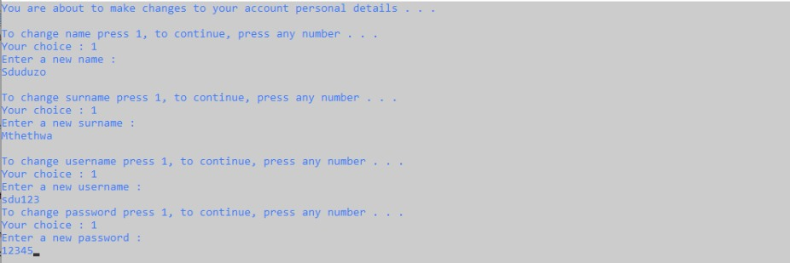
6. UPDATE DETAILS continued
If the user selects 1 (change name), they are prompted to enter a new name.
The same procedure follows through for surname, username and password

Slide 22
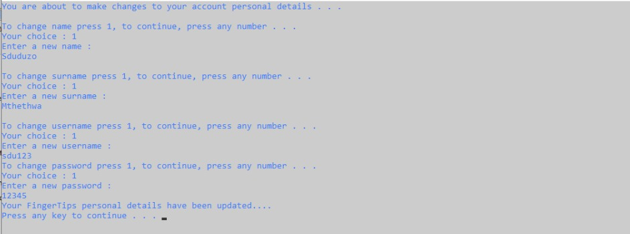
6. UPDATE DETAILS continued
Once the user presses Enter after entering a new password, a message is displayed indicating the FingerTips personal details have been updated.
The used is requested to press any key to continue using the banking app

Slide 23
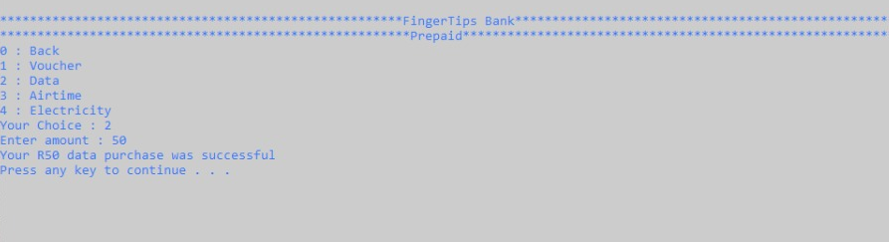
7. BUY PREPAID
If the user selects 7 (buy prepaid), they are given 5 options:
0. Back – to go back to the main menu
Voucher – to purchase a voucher
Data – to purchase data
Airtime – to purchase airtime
Electricity – to purchase electricity
The user enters their choice. E.g. 2
The user is then requested to enter the amount they want to purchase for
A successful purchase message is displayed, if the purchase was made

Slide 24
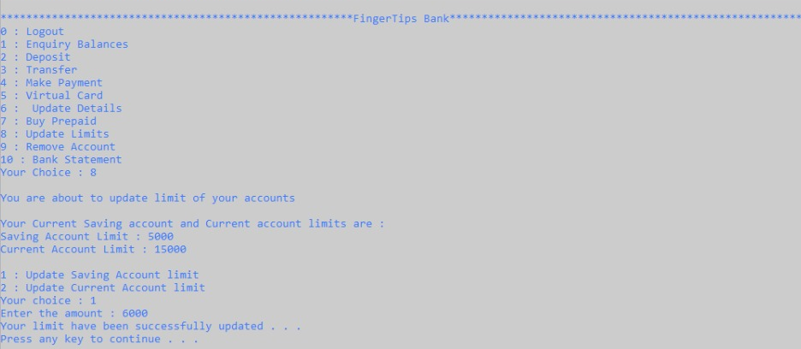
8. UPDATE LIMITS
If the user selects 8 (update limits), the following information is displayed:
Warning message that the user is about to update their limits
The current limit of the savings account
The current limit of the current account
The user is given two options:
Update Saving Account limit
Update Current Account Limit
The user enters the number of their choice, e.g. 1
The user is then prompted to enter the amount they want to update their limit to.
A confirmation message is displayed once the limit has been updated

Slide 25
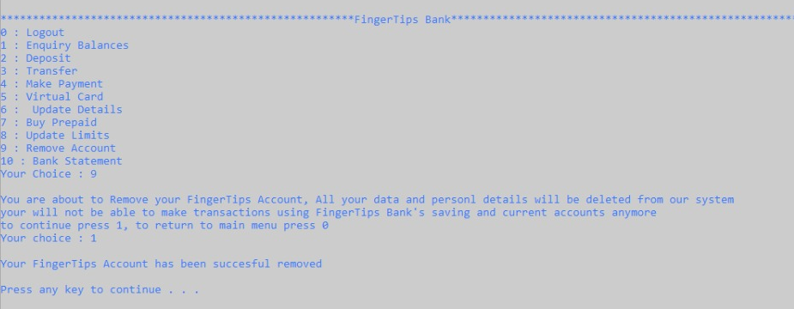
9. REMOVE ACCOUNT
If the user selects 9 (remove account), a message is displayed explaining that all data and personal details will be removed from our system and the user will no longer be able to use FingerTips banking.
The user is given two options:
0. Return to main menu
Continue
The user selects their choice. If 1 is selected, a confirmation message is displayed indicating successful removal of account

Slide 26
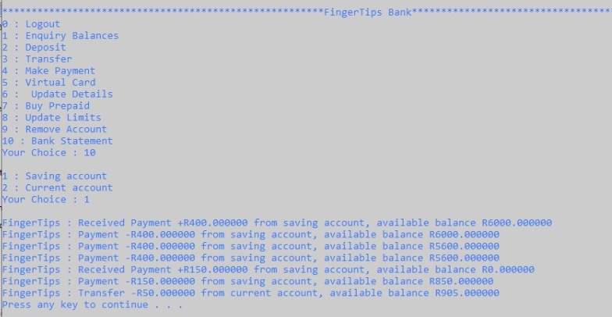
10. BANK STATEMENT
If the user selects 10 (bank statement), they are given two options:
Saving account
Current account
The user enters the number of the accounts’ bank statement they want to view
The bank statement is then displayed and the user may press any key to continue using the banking app.

Slide 27
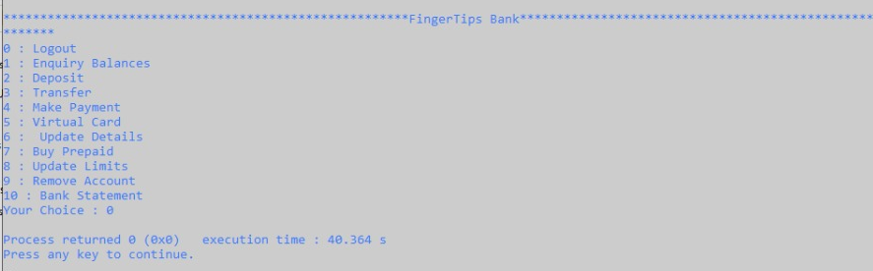
0. LOGOUT
Selecting Logout shuts down the system.

Slide 28
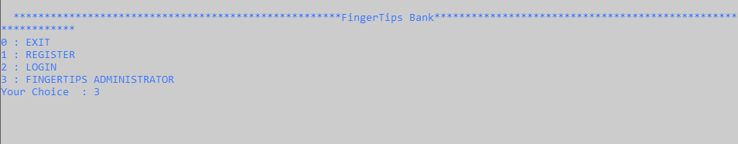
Bank Administrator’s
Banking System
Customer Accounts
FingerTip’s Bank administrators can access all user’s accounts and information on the bank database. But the customer/the user can access only their accounts infomartion
Administrators have their unique accounts, they can make changes and updates on the banking application system

Slide 29
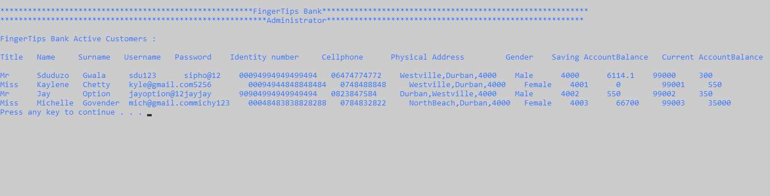
FINGERTIPS DATABASE
The above information is the banks private information
It contains all existing users of the bank and their personal details, and can be accessed by the Fingertips Bank administrator account.

Slide 30
OUR TEAM
Sipho Gwala
Siduduzo Mthethwa
Kaylene
Chetty
Xolisani
Jam Jam
Luyanda
Gumede

Slide 31
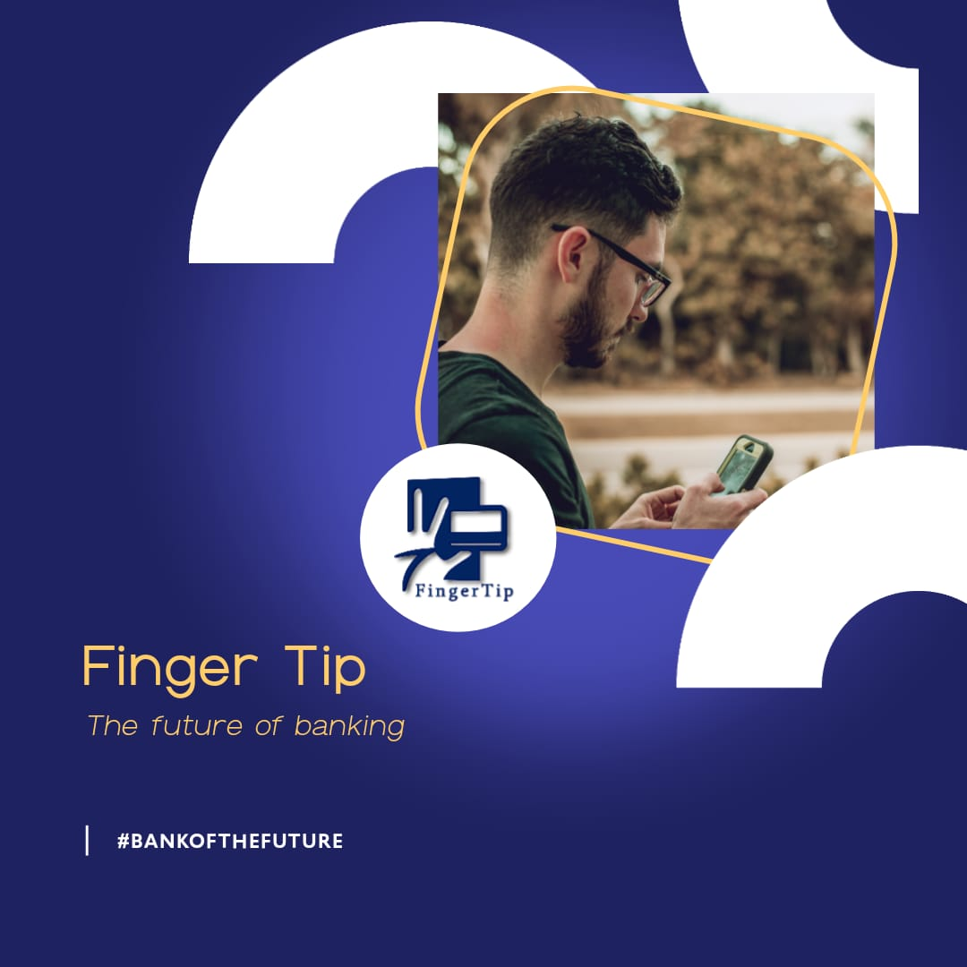
THANK YOU

